Slide 1
Subsidiary ICT for Uganda
Curriculum Topic 6 out of 15: COMPUTER SOFTWARE
Recommended Coverage Duration: 8 periods (1 ¹/₃ weeks)
Senior Five Term II
Notes:
Guidance to the Teacher
There is need to have a variety of application and systems programmes for practice. You are advised to create an activity that introduces the learner to the distinction between system software and application software.
Application software is designed to help the user to perform specific tasks while system software is responsible for managing and controlling computer hardware.
Using a variety of files with different file types, create an activity that requires a learner to determine the appropriate application software to use for each of the files.
Suggested Competences for Assessment
Assess the learners’ ability to determine the appropriate application software for each of the files and the skill to navigate and use the different application software.

Slide 2
Background
As mentioned in Topic 5 (Computer Hardware), computer software is compared to your mind. Each and everything that happens inside the computer is controlled by some form of software: from the high level word processors, games and other applications, to the low-level device drivers that tell your hardware exactly what it has to do to make them work properly. Software is a collection of computer programmes and related data that provides instructions to computer hardware. It is these instructions which tell the hardware that it needs to print a document or save a file or display a webpage, etc.
Learning Outcome: The learner should be able to describe the major categories of software and their functions.

Slide 3
Presentation Outline
UACE Sub – ICT Topic 6:
Computer Software
Sub Topic 6.1. System Software
Sub Topic 6.2. Application Software

Slide 4
Introduction
Computer software refers to the electronic instructions and procedures that control the operation of a computer.
There are two major types of software: System software and application software.
System software e.g. the Operating system manage and coordinate all the other computer programs, devices, resources and activities.

Slide 5
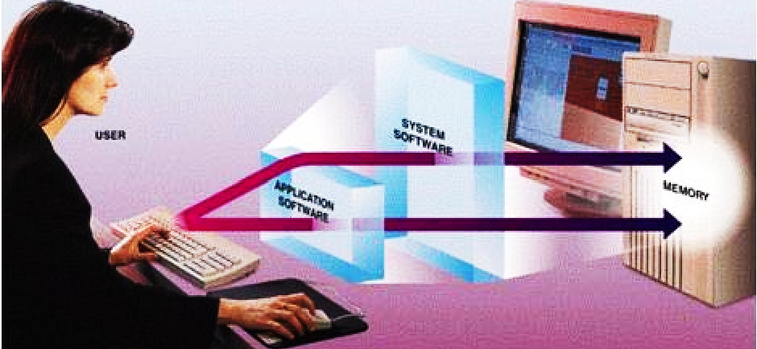
Introduction
While Application software like, Word-processors, Spreadsheets, Media players and Games solve the specific or exact needs of the user.

Slide 6
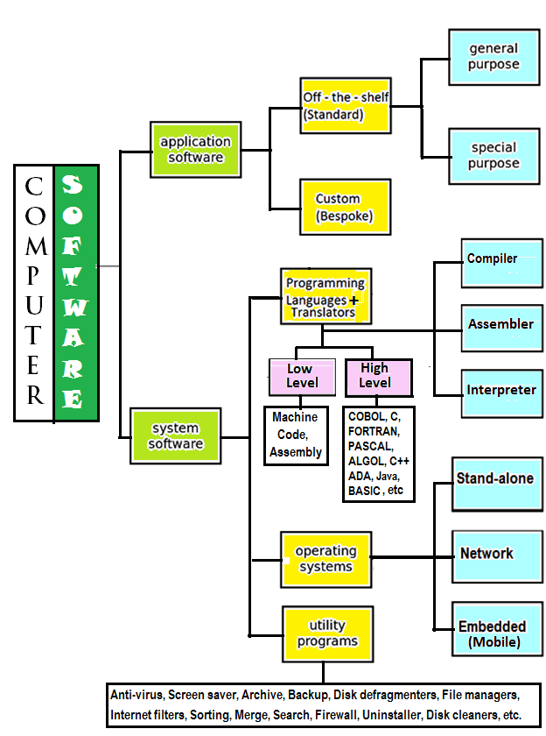
Introduction
Computer software can be generally classified and broken down as shown in the following chart:

Slide 7
Sub Topic 6.1: System Software
Sub topic Objectives:
6.1.1 Types of system software e.g. operating systems, utilities and programming languages.
6.1.2 Functions of operating systems.

Slide 8
6.1.1 Types of system software
System software is a set of programs that control or maintain all the operations of the computer and its devices, such as the CPU, communication links, and peripheral devices.
System Software Includes:
An Operating system,
Device Drivers, Firmware,
Utility Programs and
Programming Languages,Translators and Library Programs

Slide 9
Operating Systems
An operating system is a generalized program that manages and coordinates all the activities taking place within a computer system.
The operating system functions as a middleman between the user and the computer, as well as between application software programs and the hardware devices.

Slide 10
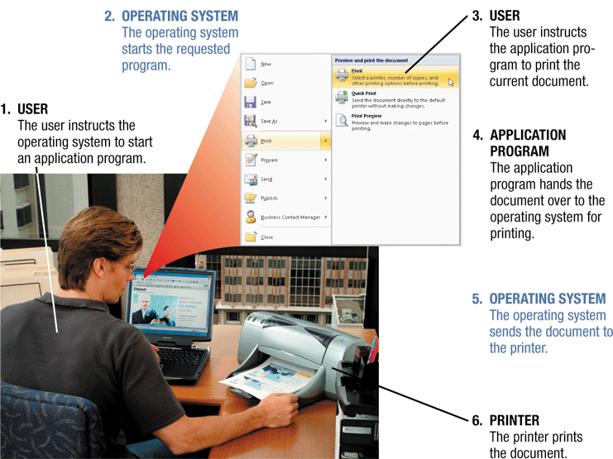
Device Drivers

Slide 11
Operating Systems
Device Drivers
To communicate with the hardware devices, the operating system relies on device drivers.
A device driver is a program that accepts instructions and then converts them into commands that the device understands.
Each device on a computer, such as the keyboard, mouse, monitor, printer, card reader/writer, and scanner, has its own device driver.

Slide 12
Where does the OS reside?
In most cases, the operating system is installed and resides on the computer's hard disk.
During the boot process, usually the operating system will look first in drive C: (the designation for the hard disk drive) for the OS system files.
On handheld computers and many mobile devices such as smart phones, however, the operating system may reside on a ROM chip.
Permanently written data, instructions, or programs written to a ROM chip with in a device by its manufacturers are collectively called firmware.

Slide 13
Types of operating systems
Early operating systems were proprietary and device -dependent.
A device-dependent program is one that runs only on a specific type or brand of computer.
Proprietary software is privately owned and limited to a specific computer model.
The trend today is toward device-independent operating systems that will run on computers provided by a variety of manufacturers.
Three basic categories of operating systems exist today.
They are stand-alone OS, network OS, and embedded OS.

Slide 14
Stand-alone operating systems
A stand-alone operating system is a complete operating system that works on a PC.
Examples of popular stand-alone operating systems include:
Mac OS X, UNIX, Linux, MS-DOS and Windows (XP, Windows Vista, Windows 7, Windows 8, Windows 10 etc.).

Slide 15
Mac OS
Macintosh operating system was released in 1984 with Apple’s Macintosh computers.
Mac OS X includes features such as a GUI, multitasking, large photo-quality icons,
built-in networking support, email, online shopping, enhanced speech recognition,
CD burning, and enhanced multimedia capabilities.

Slide 16
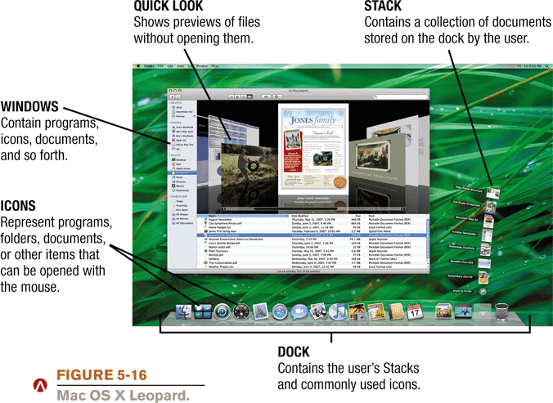

Slide 17
UNIX
UNIX is a multitasking operating system developed in the early 1970s by scientists at Bell Laboratories.
Some versions of UNIX have a command-line interface, and others offer a graphical user interface.
Power users often work with UNIX because of its flexibility and power.
Manufacturers such as Sun and IBM often sell personal computers and workstations with a UNIX operating system.

Slide 18
Linux
Linux is one of the fastest growing operating systems.
Linux is a free, open source, UNIX-like operating system.
Open source software means its code is provided for use, modification, and redistribution. It has no restrictions from the copyright holder.
Some versions of Linux are command-line. Others are GUI.
Linux comes with very many utilities and applications such as open office.
A Live CD of Linux allows users to boot from it and preview the operating system without installing it.

Slide 19
MS-DOS
In the early 1980s, Bill Gates’ Microsoft Corporation introduced DOS (Disk Operating System) as its first operating system for IBM PCs.
DOS originally used a command-line interface.
Later versions of DOS included both command-line and menu-driven user interfaces.
Today, DOS is rarely used because it does not offer a graphical user interface and it cannot take full advantage of modern computer microprocessors.

Slide 20
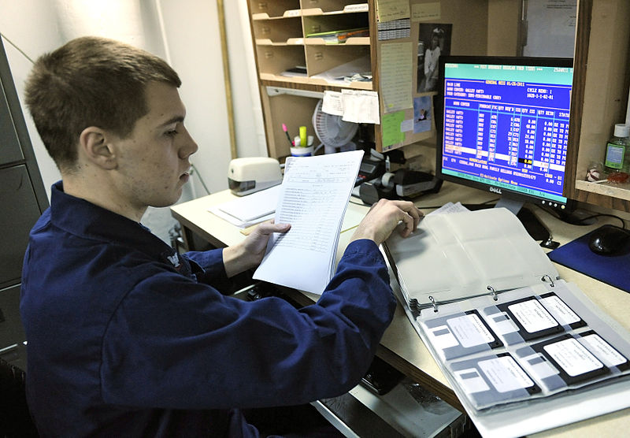
US_Navy_Specialist_uses_the_existing_DOS-based _food_service_management_system _2011

Slide 21
Microsoft Windows
Microsoft introduced an operating environment named Windows 1.0 on November 20, 1985.
It was Microsoft's first attempt to implement a multi-tasking graphical user interface-based operating environment on the PC platform.
Since then, Many versions have been released, each with various new innovative features and functions.
These include Windows 2.0, Windows 95, 98, Me, Windows NT 3.1, Windows 2000, Windows XP, Windows Vista, Windows 7, Windows 8, Windows 8.1 and Windows 10

Slide 22
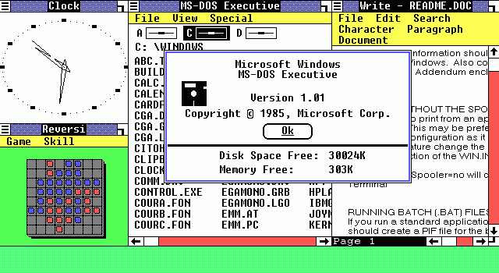
Screenshot of Windows 1.01

Slide 23
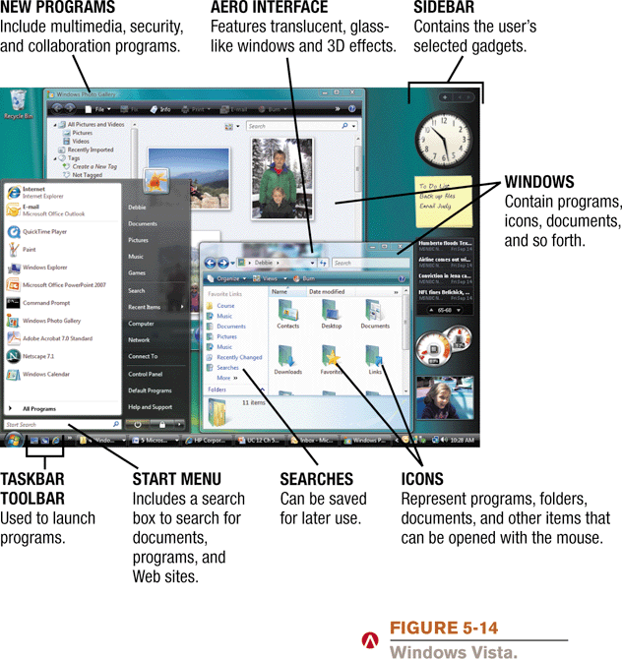
Windows Vista Features
Windows Vista

Slide 24
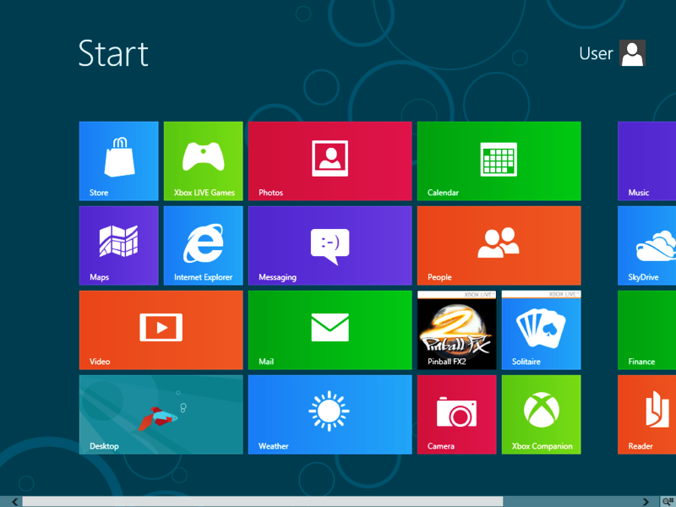
Windows 8 Start Screen (Replaced the start menu)
Windows 8 Start Screen

Slide 25
Network Operating Systems
A network operating system (NOS) is an operating system that supports a network and typically resides on the server.
Some stand-alone OS systems include networking capability.
However, network operating systems are designed specifically to support all sizes of networks.
Examples of network operating systems include Windows Server 2003, 2008, Solaris, and NetWare, UNIX server, and Linux server.

Slide 26
Embedded Operating Systems
An embedded operating system is an operating system that resides on ROM chips and typically used on handheld computers and small devices.
Popular embedded operating systems today include Windows Embedded CE, Windows Mobile, Palm OS, Embedded Linux, and Symbian OS.

Slide 27
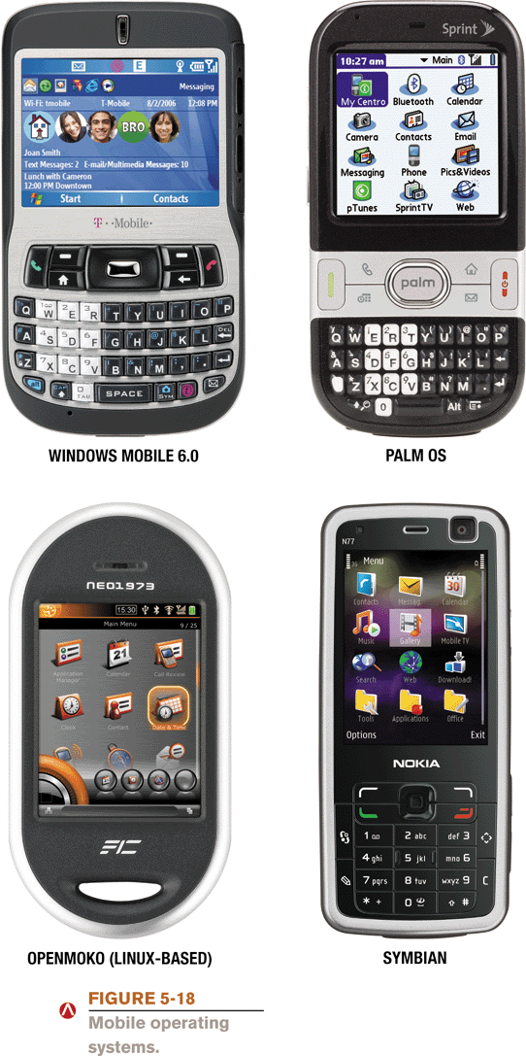
Embedded Operating Systems

Slide 28
Factors to consider when choosing an operating system
When choosing an operating system for a computer the following factors may be considered:
The type of computer in terms of size and make. Operating systems are available for all sizes of computers.
The hardware configuration of the computer such as the memory capacity, processor speed and hard disk capacity should meet the required minimum requirements for a the operating system to run well.

Slide 29
Factors to consider when choosing an operating system
The application software to be installed on the computer should be supported by the operating system. For example Microsoft Office 2010 cannot run on Windows 2000.
The operating system should be user friendly. This depends on the skills of the intended users of the computers.
The operating system should have adequate information and help guides for user reference.

Slide 30
Factors to consider when choosing an operating system
The cost of the operating system.
Reliability and security provided by the operating system.
The number of processors and hardware devices it can support.
The number of users it can support
The availability of basic utilities and accessory programs within the operating system.

Slide 31
Utility Programs
Utility software refers to system software designed to analyze, optimize, enhance and maintain a computer in good working conditions.
Utility software usually focuses on how the computer system operates. Although operating systems typically include some built-in utilities, many stand-alone utility programs are available.
Examples include Antivirus, screen saver, file compression, backup, disk checkers, disk cleaners, disk defragmenters, file managers, sort, merge, personal firewall, uninstaller, diagnostic utility, etc.

Slide 32
Utility Programs
Antivirus utilities are programs that scan for computer viruses, block, remove, and disinfect files.
A screen saver is a program that automatically fills the computer’s screen with moving images or patterns when the computer is not in use. Screensavers were originally designed to prevent phosphor burn-in (ghosting) on CRT monitors. Currently, screensavers are used primarily for entertainment, advertising or security purposes.
Backup utilities can make a copy of data stored on a disk, and can restore it in case of data loss.
Cryptographic utilities encrypt and decrypt streams and files.
Disk checkers can scan the contents of a hard disk to find files or areas that are corrupted in some way, or were not correctly saved.
Disk cleaners can find files that are unnecessary to computer operation, or take up considerable amounts of space.
Disk defragmenters can detect computer files whose contents are broken and spread across several locations on the hard disk, and combine the fragments to increase efficiency.
A search utility is a program that attempts to locate a file on your computer based on criteria you specify.

Slide 33
Utility Programs
Disk partitioning utility can divide an individual drive into multiple logical drives, each with its own file system which can be mounted by the operating system and treated as an individual drive.
Archive utilities output a stream or a single file when provided with a directory or a set of files. Archive suites, at times include compression and encryption capabilities.
File managers provide a convenient method of performing routine data management tasks, such as deleting, renaming, cataloging, moving, copying, merging, generating files and modifying data sets.
Merge utility for merging or combining different files in one.
A file compression utility shrinks the size of a file.
A personal firewall is a utility that detects and protects a personal computer from unauthorized intrusions.
An uninstaller is a utility that removes a program, as well as any associated entries in the system files.
A diagnostic utility compiles technical information about your computer's hardware and certain system software programs and then prepares a report outlining any identified problems.
A sort utility organizes files in any chosen order.

Slide 34
Programming Languages
A programming language is a notation for writing computer software.
Programming languages are can be used to create the procedures and specifications of a computation or algorithm.
When computers execute programs written in languages such as BASIC, C, Java, etc., the computer must convert these humanly readable instructions into a form it can understand.
Compilers, interpreters, and assemblers are special language translation library programs that translate the higher-level language programs into the lowest level machine language that the computer can execute.

Slide 35
6.1.2 Functions of operating systems
Most operating systems provide similar functions that are outlined as follows :
Starting a computer, (Booting the computer)
Providing a user interface,
Managing programs,
Configuring devices, (Device drivers are often needed). Plug and Play devices are recognized automatically.
Monitoring performance
Providing file management.
Administering security.
Managing resources.
Coordinating tasks, and Spooling.
Managing memory,
Establishing network connections

Slide 36
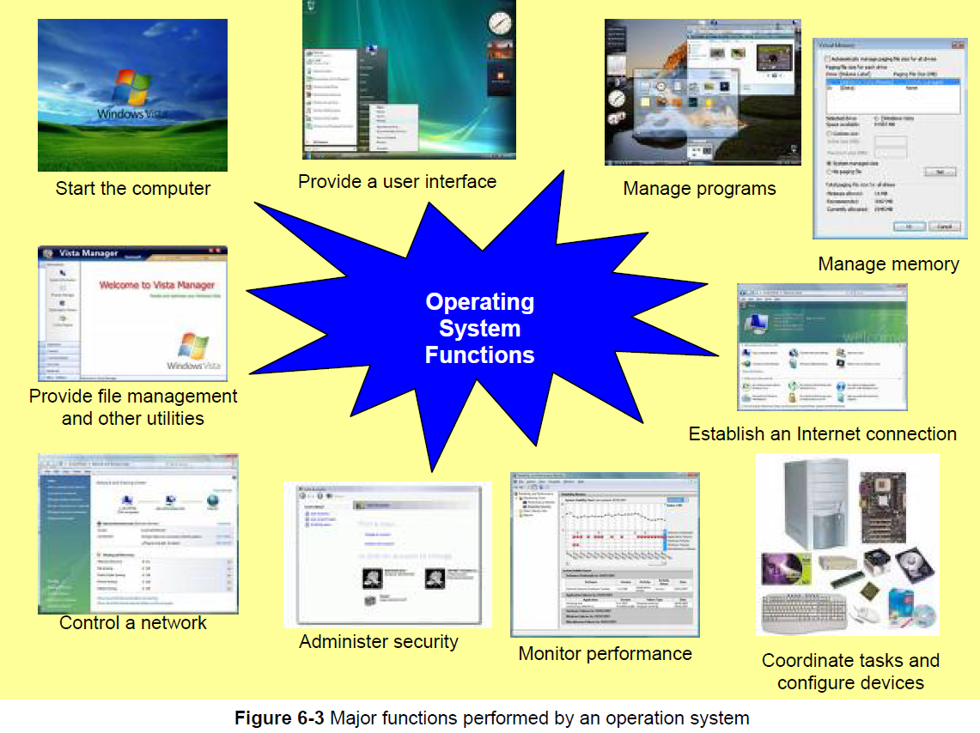
6.1.2 Functions of operating systems

Slide 37
a) Starting a computer, (Booting the computer)
The process of starting or restarting a computer is mainly managed by the operating system.
When you instruct the computer to Turn Off, (See figure), the operating system properly closes any open processes and programs, saves your settings, and shuts down the computer.

Slide 38
b) Providing a User Interface
Computer users interact with software through its user interface.
A user interface is the part of the software with which you interact; it controls how data and instructions are entered and information is presented on the screen.
It is through the user interface of an operating system that you communicate with the computer.

Slide 39
Types of user interfaces
Three types of user interfaces are:
command-line interface (CLI),
menu-driven interface (MDI), and
graphical user interface (GUI).
Most operating systems use a combination of these types of user interfaces to define how you interact with your computer.

Slide 40
Command-line interface

Slide 41
Command-line interface
Command-line interfaces often are difficult to use because the commands used require exact spelling and punctuation.
Minor syntax errors, such as a missing period, generate error messages.
Command-line interfaces, however, give a user more control to manage detailed settings, and execute programs faster.

Slide 42
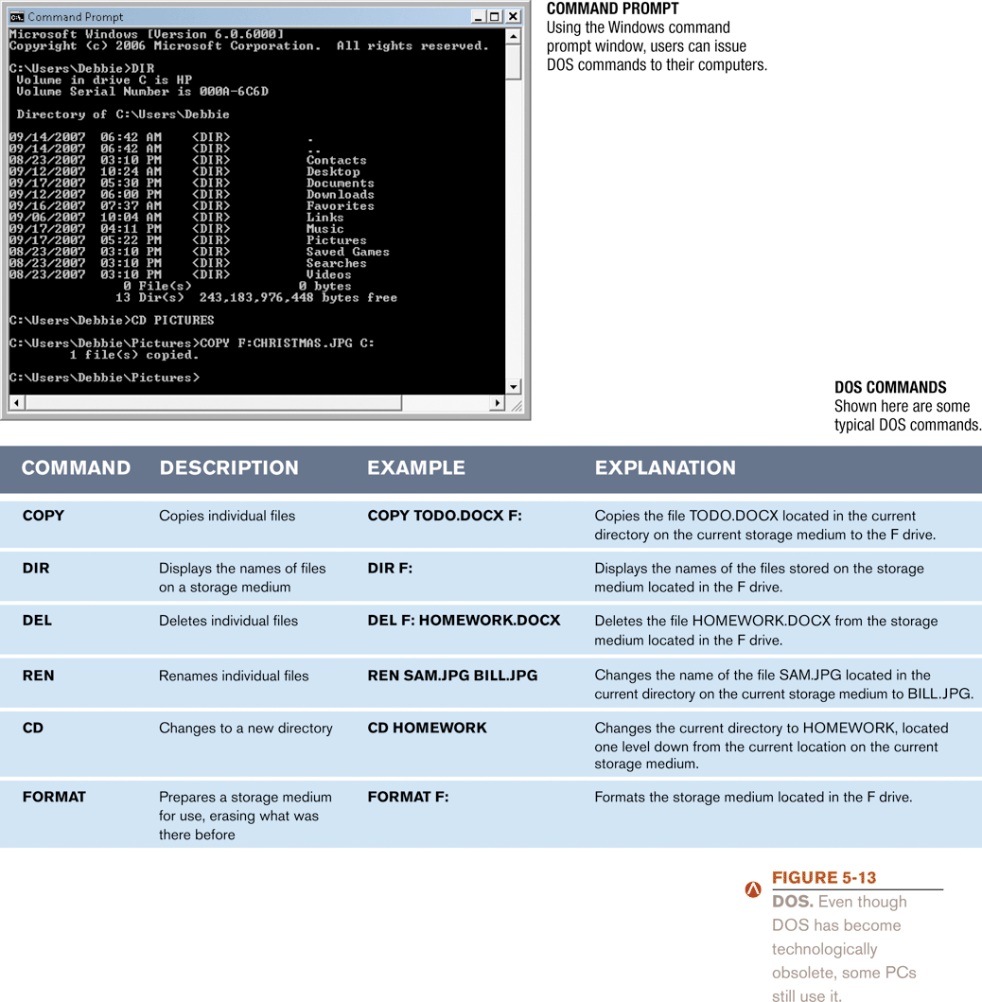
Command-line interface (cont)
Shown here are some typical CLI commands.
NB To view a list of more common commands, type help at the command prompt.

Slide 43
Menu-driven interface
A menu-driven interface provides menus as a means of entering commands.
Menu-driven interfaces are easier to learn than CLI because users do not have to cram keywords for commands.
The characteristic of being easy to learn and use is described as being user-friendly.

Slide 44
Menu-driven interface

Slide 45
Graphical User Interface (GUI)
Most of today's software programs have a graphical user interface (GUI).
A GUI is a user Interface in which visual images such as icons and buttons are used to issue commands.
Of all the interfaces a GUI typically is the most user friendly, because it does not require you to know any command language.

Slide 46
Disadvantages of a GUI as compared to CLI
GUI requires the computer to have more RAM as compared to Command Line.
Command line instructions execute faster than GUI instructions.

Slide 47
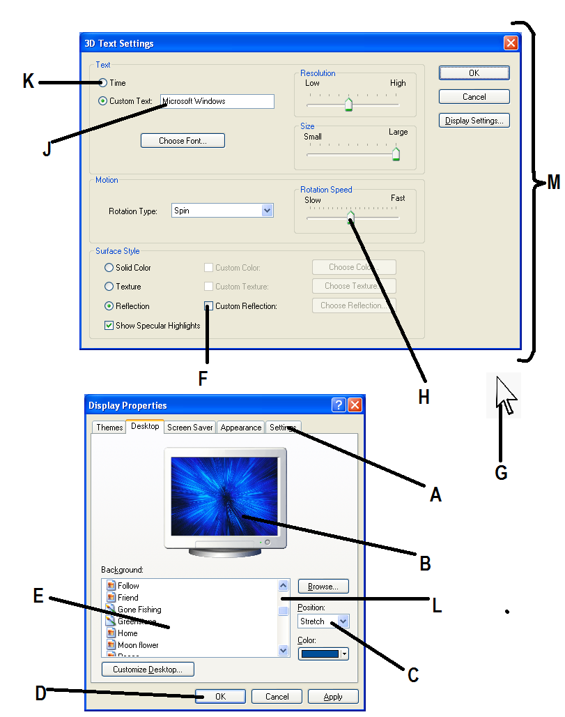
Examples of Elements/ Objects of a GUI

Slide 48
Examples of Elements/ Objects of a GUI
Icons
Command Buttons
Drop Down Lists
Check boxes
List Boxes
Dialogue boxes
Windows
Cursor
Scroll bars
Radio Buttons
Preview areas
Slider buttons
Tabs
Menus
Text boxes
Toolbars
e.t.c.

Slide 49
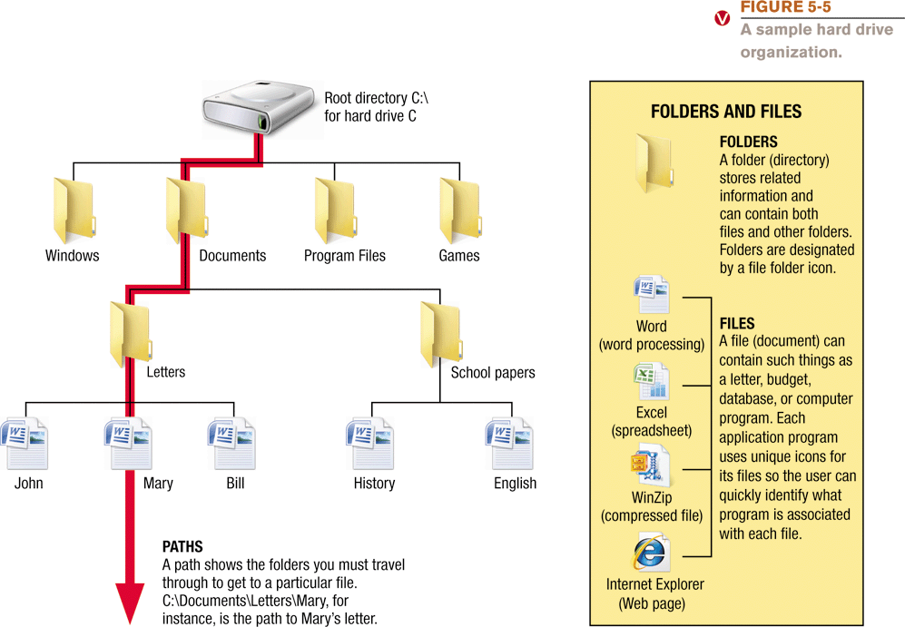
c) File management
The operating systems help to organize files and folders on a computer’s hard disk drive.

Slide 50
d) Managing Programs
Operating systems can support just one user running one program or many of users running multiple programs.
These various capabilities of operating systems are described as
(i) single tasking,
(ii)Single-user and multi-user,
(iii) multitasking, and
(iv)multiprocessing,

Slide 51
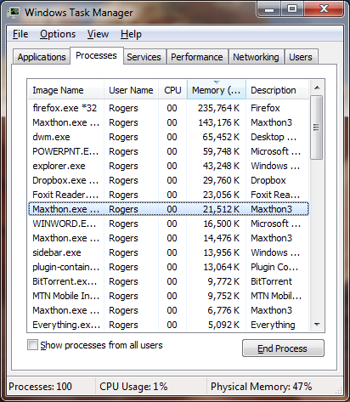
d) Managing Programs (cont)
In addition to application programs, an operating system manages other processes.
Some of these processes are memory resident.
They include utilities and routines that provide support to other programs or hardware.
.

Slide 52
e) Managing Memory
The purpose of memory management is to optimize the use of RAM. RAM holds data and instructions while the processor is using them.
The operating system allocates, data and instructions to an area of memory while they are being processed, and carefully monitors the contents of RAM.
Finally, the operating system releases these items from RAM when the processor no longer requires them.

Slide 53
e) Managing Memory (cont.)
If you have many programs running at a go, it is possible to run out of RAM. So, the OS may have to use virtual memory.
With virtual memory, the operating system allocates a portion of a storage medium, usually the hard disk, to function as additional RAM.
As you interact with a program, part of it may be in physical RAM, while the rest of the program is on the hard disk as virtual memory.
Users may notice the computer slowing down while it uses virtual memory, because virtual memory is slower than RAM.
The area of the hard disk used for virtual memory is called a swap file

Slide 54
f) Coordinating Tasks
The operating system determines the order in which tasks are processed.
A task, or job, is a piece of work or operation that the processor manages.
Tasks include receiving data from an input device, processing instructions, sending information to an output device, and transferring items from storage to memory and from memory to storage.
Thousands of tasks can be going on in a computer simultaneously.

Slide 55
f) Coordinating Tasks (cont.)
Sometimes, a device may be busy processing one job when it receives a second job.
This occurs because the processor operates at a much faster rate of speed than peripheral devices.
For example, if the processor sends five print jobs to a printer, yet the printer can print only one document at a time.
When this happens, the OS allocates / assigns memory to the jobs in the execution queue in an area called the buffer.

Slide 56
f) Coordinating Tasks (cont.)
A BUFFER is an area of memory or storage in which data and information is placed while waiting to be transferred to or from an input or output device.
Operating systems typically use a technique called spooling to increase computer system efficiency.
SPOOLING refers to the process of putting tasks that need to be done into a buffer until they can be executed.
The operating system commonly uses a print spooler with print jobs. A print spooler, intercepts documents to be printed from the operating system and places them in the queue in the buffer.
As soon as the print job is placed in the buffer, the CPU is available to process the next instruction.

Slide 57
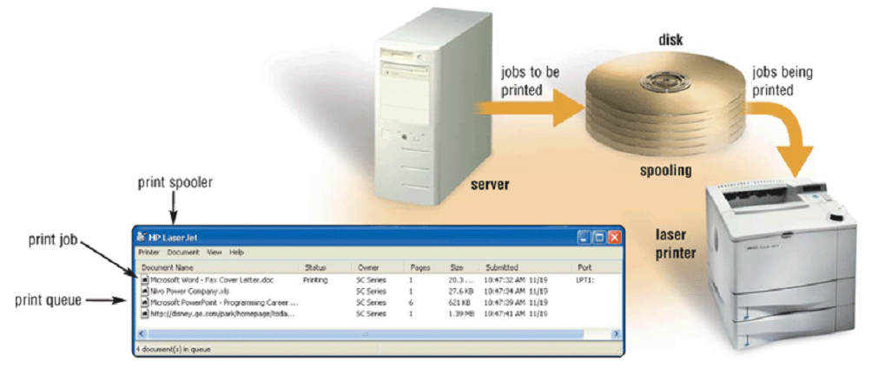
Spooling (illustration)
Spooling increases both processor and printer efficiency by placing print jobs in a buffer on disk before they are printed.

Slide 58
g) Configuring Devices
If you add a new device to your computer, such as a printer, its driver must be installed before the device will be operational.
For devices with Plug and Play support, the OS recognizes the new device and loads the necessary drivers automatically.
It also checks for conflicts with other devices.

Slide 59
g) Configuring Devices (cont)
For devices that are not Plug and Play, Windows operating system provides a wizard to guide users through the installation steps.
If you have an Internet connection, the Wizard will search an online repository of device drivers.
If Windows still is unable to find a driver, you can download one from the manufacturer's Web site manually.
Alternatively you can install the drivers from a CD-ROM provided with the purchased device.

Slide 60
h) Establishing an Network Connection
Operating systems typically provide a means to establish Network connections.
This is through a "Connect to a network" Wizard that guides users through the process of setting up a connection between a computer a network provider.
Some operating systems also include a Web browser and an e-mail program, enabling you to begin using the Web and communicate with others as soon as you set up the Internet connection.

Slide 61
i) Monitoring Performance
The OS monitors the performance of the computer system.
It keeps track of each computer job, the various system resources and devices, the processor usage, the amount of unused physical RAM, and network usage.
Operating systems typically contain a performance monitor.
A performance monitor is a program that assesses and reports information about various computer resources and devices.
The information in performance reports helps users and administrators to identify a problem with the resources so they can try to resolve any problems.

Slide 62
j) Administering Security
The OS helps users to administer computer access security by use of a user name or user ID and a password, before a user logs on to, a computer.
After entering a user ID and password, the operating system compares the user's entry with a list of authorized user names and passwords.
If the entry matches the user name and password kept on file, the operating system grants the user access.

Slide 63
j)Administering Security (cont)
To protect sensitive data and information as it travels over the network, a network operating system may encrypt it to prevent unauthorized users from reading the data.
Encryption is the process of encoding data and information into an unreadable form.
When an authorized user attempts to read the data, it is decrypted, or converted back into a readable form.

Slide 64
Sub Topic 6.2. Application Software
Sub topic Objectives:
6.2.1 To be able to identify and describe the different types of application software (with examples).
Focus on types of application software will be on Off-shelf, Custom-tailored, Shareware, Freeware and Open-source application software.
6.2.2 To be able to explain the uses of application software.

Slide 65
6.2.1 Types of Application Software
Application software consists of programs designed to perform specific tasks for end-users.
The common Classifications of application software include:
Off-the-shelf (standard) software,
Custom (bespoke) software,
Shareware, Freeware,
Open-source, Public-domain software,
Web-based software, copyrighted software,
Special Purpose and General purpose.

Slide 66
Off-shelf software
This refers to packaged software that is designed to meet the needs of a wide variety of end users.
Off the shelf software is mass-produced, commercially sold software, and copyrighted.
Microsoft Office Word and Adobe Photoshop are examples of Off the shelf software.

Slide 67
Custom (bespoke) software,
Custom software is tailor-made software, which is developed at a user's request to perform specific functions.
Sometimes, when a company cannot find packaged soft-ware that meets its unique requirements, it pays computer programmers to write custom software that is specifically tailored to meet the needs of the company.
Custom software usually costs more than packaged software.

Slide 68
Comparison of the characteristics Standard and Custom Software
STANDARD SOFTWARE IS… | CUSTOM SOFTWARE IS…
1. Easy to use, because it is known by many people. | 1. Unique, and requires extensive training before use.
2. Cheaper because it is massively produced and packaged for commercial purposes. | 2. Expensive because it requires hiring a programmer.
3. Easy to acquire because it is already made. | 3. Difficult to acquire due to the time needed for programming it.
4. More reliable because it is tried and well tested by many users. | 4. May contain programming errors since it is not tested adequately.
5. Containing online help to guide users in case of any problems in use. | 5. Usually lacking online help services.
6. Can not be modified or changed to meet unique user requirements. | 6. Meets all user requirements and can be edited if need arises.

Slide 69
Copyrighted software
Copyrighted software refers to computer programs with restrictions regarding use, modification, and redistribution.
You have to pay for copyrighted software and must not copy it without permission from the manufacturer.
Copying copyrighted software without paying for it is clearly unethical and illegal.

Slide 70
Shareware
Shareware is copyrighted software that is distributed at no cost for a trial period.
To use a shareware program beyond that period, you send payment to the program developer.
In some cases, a scaled-down version of the software is distributed free, and payment entitles the user to the fully functional product.

Slide 71
Freeware
Freeware is copyrighted software provided at no cost by an individual or a company that retains all rights to the software.
Therefore, other programmers cannot include freeware in applications they intend to sell.

Slide 72
Open-source
Open source software is software provided for use, modification, and redistribution. This software has no restrictions from the copyright holder.
Open source software usually can be downloaded from the Web at no cost.

Slide 73
Public-domain software
Public-domain software has been donated for public use and has no copyright restrictions.
Anyone can copy or distribute public-domain software to others at no cost.

Slide 74
Web-based software
Web-based software refers to programs hosted by a Web site.
Users access and interact with Web-based software from any computer or device that is connected to the Internet.
Many Web sites allow free access to their programs; some charge a fee.
Examples of Web-based software include e-mail, Website builders, online games, travel and mapping software ,e.t.c.

Slide 75
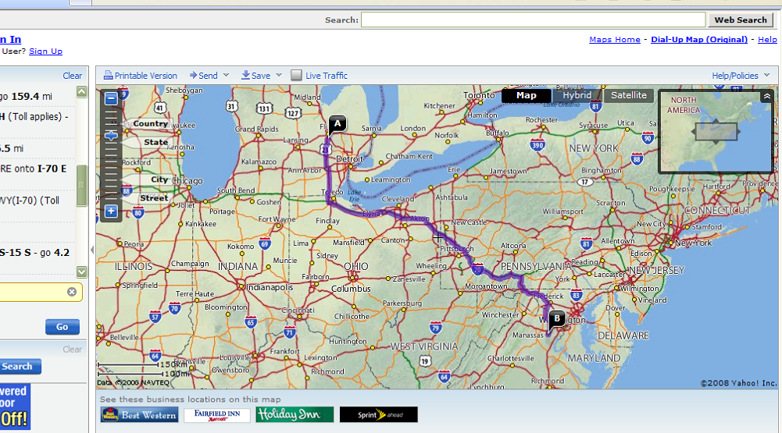
Web-based software

Slide 76
Special Purpose (Specialized) Software
This refers to computer programs developed and dedicated to accomplish particular jobs only.
Programs that run on special purpose computers like ATMs are special purpose software.
Other Examples of specialized software include:
Business – Transaction and Sales Management software.
Science and Engineering software etc..

Slide 77
General purpose software
This refers to a Wide a variety of application programs that perform many common tasks.
Varieties of General purpose application programs include Word processing programs, Spreadsheet programs, web browsers, Graphics programs, etc.

Slide 78
6.2.2 Uses of Popular Application software packages and their Examples
(A). Word Processors – Used for producing textual documents like letters, notes, reports, memos, etc. Examples Include:
WordPerfect,
Lotus Word Pro,
Word Star,
OpenOffice.org Writer,

Slide 79
Uses of Popular Application software varieties and their Examples
(B). Spread sheet software - Used for performing calculations, and the creating of graphs. Examples include:
Microsoft Excel,
Lotus 1-2-3,
KSpread,
OpenOffice.org Calc,

Slide 80
Uses of Popular Application software varieties and their Examples
(C).Database management software (DBMS)- Used to create and manage an organized collection of related and structured information (a database). Examples include:
Lotus Approach,
Microsoft Access,
OpenOffice.org Base,
Corel Paradox,

Slide 81
Uses of Popular Application software varieties and their Examples
(D). Presentation software - These applications are used for making presentations and slide shows that can aid a speech presentation. Examples include:
Screencast ,
Microsoft PowerPoint,
OpenOffice.org Impress,
Adobe Persuasion,

Slide 82
E) Communications software
One of the main reasons people use computers is to communicate and share information with others. A variety of communications software options exist. Common communications software includes Web browsers, e-mail software, chat rooms, newsgroups, Text messaging, FTP programs, blog software, and teleconferencing software.

Slide 83
Uses of Popular Application software varieties and their Examples
(F).Computer aided design (CAD) software - Used by engineers and architects to produce technical drawings such as designs of building structures and floor plans
Examples include
ArchiCAD,
AutoCAD, e.t.c.

Slide 84
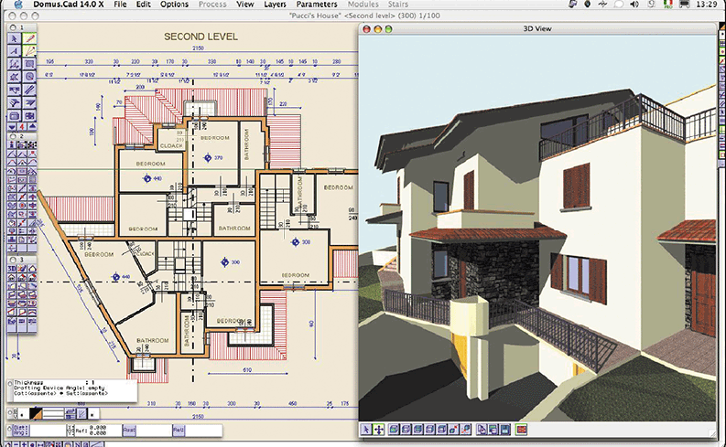
CAD software - illustration

Slide 85
Uses of Popular Application software varieties and their Examples
G). Desktop publishing software - These are applications used for creating publications like cards, flyers, calendars, brochures, Newsletters, Certificates, etc. Examples include:
Microsoft Publisher,
Celframe Publisher,
Adobe Page Maker,
e.t.c.

Slide 86
Uses of Popular Application software varieties and their Examples
(H).Web browsing software for displaying Webpages from the internet or html documents on computers. Examples Include:
Mozilla Firefox,
Internet Explorer,
Safari,
Opera
Netscape Navigator, e.t.c.

Slide 87
Uses of Popular Application software varieties and their Examples
(I). Web authoring software – Used by webmasters for building websites. Examples include:
Microsoft FrontPage,
Adobe Dreamweaver,
Microsoft Expression Web,
Antenna Web Design Studio

Slide 88
Uses of Popular Application software varieties and their Examples
(J). Media Players for Audio and Video playback on computers. Examples include:
Windows Media Player,
Nero Showtime,
JetAudio,
Power DVD,
VLC Media Player, e.t.c.

Slide 89
Uses of Popular Application software varieties and their Examples
(K). Graphics software – Used by graphic designers to create and design artistic graphics and to manipulate visual images on a computer such as logos, cartoons etc. Examples include
Paint,
Adobe Photo shop,
Corel Draw,
Adobe Illustrator etc.

Slide 90
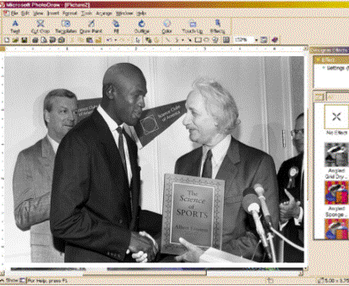
Graphics Software - Illustration
A digitally altered photograph shows sports star Michael Jordan (born 1963) meeting famous scientist Albert Einstein (who died in 1955).

Slide 91
Uses of Popular Application software varieties and their Examples
(L) Accounting software helps companies to record and report their financial transactions.
With accounting soft-ware, you perform accounting activities related to the general ledger, accounts receivable, accounts payable, purchasing, invoicing, job costing, payroll functions, etc.
Examples include Quick Books

Slide 92
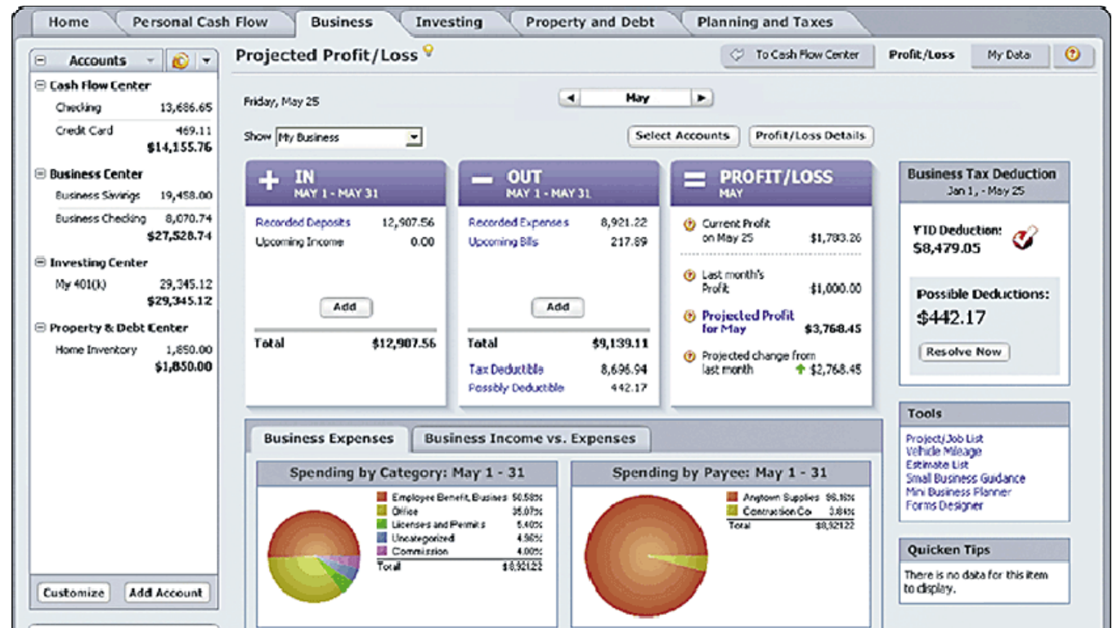
Accounting software

Slide 93
M) Audio and video editing software
Audio editing software lets users produce studio quality soundtracks.
With video editing software, you can modify video clips: you can reduce the length of a video clip, reorder a series of clips, or add special effects such as words that move horizontally across the screen, etc.

Slide 94
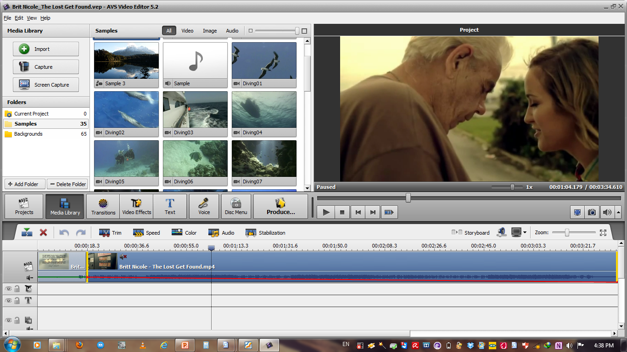
Audio and video editing software

Slide 95
N) Images Viewing software
This refers to computer applications primarily used for previewing digital photographs on the computer screen.
Many have basic features such as viewing thumbnails, slideshows, printing and simple editing such as cropping and resizing.
Examples of Image viewers include: Microsoft Office Picture Manager, Windows Photo viewer, Picasa photo viewer, etc.

Slide 96
O) Reference software
Reference software provides valuable and thorough information for all individuals.
Popular reference software includes encyclopedias, dictionaries, health/medical guides, and travel directories.
Examples include:
Encyclopaedia Britannica 2011 Ultimate Reference DVD
Microsoft Student with Encarta Premium, e.t.c.

Slide 97
P) Note Taking software
Note taking software enables users to enter typed text, handwritten comments, drawings, or sketches anywhere on a page and then save the page as part of a notebook .
The software can convert handwritten comments to typed text or store the notes in handwritten form.
Examples include Microsoft Office OneNote

Slide 98
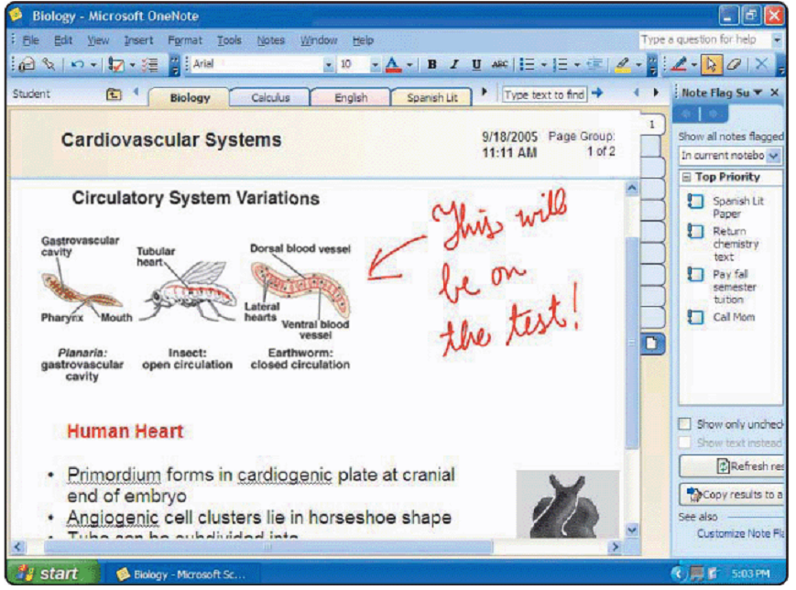
Note Taking software

Slide 99
Q) Text Editors
Text editors are simple word processors that are generally used to type without any special formatting.
Text editors are mainly used to create small notes, memos and programs.
Examples of common text editors are: Notepad, Notepad++, Sublime Text, Gedit etc.

Slide 100
R) Gaming Software
These are programs developed as electronic game that involve human interaction with a user interface to generate visual feedback on a computer.
Common computer games include solitaire, chess titans, Racing, StarCraft, Need for Speed, e.t.c.

Slide 101
S) Email Software / Email client
Email software (Commonly known as email client) is a computer program used to access and manage a user's email account.
Web applications that provide message management, composition, and reception functions are sometimes also commonly referred to as webmail.
Popular locally installed email clients include Microsoft Outlook, Pegasus Mail, Mozilla's Thunderbird, KMail, Evolution and Apple Mail.
Popular web-based email clients include: GMail, Yahoo! Mail, mail.com, Lycos mail, and Hotmail.

Slide 102
Software Suites
A software suite is a collection of individual application soft-ware programs sold as a single package. When you install the suite, you install the entire collection of applications at once instead of installing each application individually.
Types of software suites include the following:
Internet suite. Internet suites usually include a web browser, e-mail client, download manager, HTML editor, and an IRC client. Examples include Mozilla Application Suite and SeaMonkey internet suite
Graphics suite. . A collections of programs for graphics work that are distributed together. Most graphics application suites include at least a bitmap graphics editor and a vector graphics editor. Examples include Adobe graphics suite and CorelDRAW Graphics Suite.

Slide 103
Software Suites
Office suite. An office suite is a collection of bundled productivity software intended to be used by knowledge workers. The earliest office suite for personal computers was Starburst in the early 1980s, comprising the word processor WordStar, together with companion apps CalcStar (spreadsheet) and DataStar (database). Currently, Microsoft Office Software suite is the most popular suite used wordwide.
At a minimum, office suites typically include the following software applications: word processing, spreadsheet, database, and presentation graphics. The following table shows details of the popular Office Suites

Slide 104
Popular office software suites
SUITE NAME | Word Processor | Spreadsheet | Presentation Program | Database Management Software
Lotus Smart Suite | Lotus Word Pro | Lotus 1-2-3 | Lotus Freelance Graphics | Lotus Approach
Microsoft Office | Microsoft Word | Microsoft Excel | Microsoft PowerPoint | Microsoft Access
KOffice | KWord | KSpread | KPresenter | Kexi
OpenOffice.org | OpenOffice.org Writer | OpenOffice. org Calc | OpenOffice. org Impress | OpenOffice. org Base
WordPerfect Office | WordPerfect | Quattro Pro | Corel Presentations | Corel Paradox

Slide 105
Popular office software suites
SUITE NAME | Word Processor | Spreadsheet | Presentation Program | Database Management Software
Celframe Office | Celframe Write | Celframe Spreadsheet | Celframe Power Presentation | Celframe Data Access
Ability Office | Ability Write | Ability Spreadsheet | Ability Presentation | Ability Database
Kingsoft Office | Kingsoft Writer | Kingsoft Spreadsheets | Kingsoft Presentation | (None)
Apple iWork | Apple Pages | Apple Numbers | Apple Keynote | (None)

Slide 106
Advantages of using software suites
Costs significantly cheaper than buying each of the application package separately
Easy to learn and use because applications within a suite usually use a similar interface and share common features such as clip art and toolbars.
Programs integrated together in a software suite can interact with each other, sometimes in ways that the operating system would not normally allow.
Easy installation because all the various applications can be installed at once.

Slide 107
Factors to consider before obtaining a software program
correctness — the software should do what it is supposed to do, according to the design specifications.
robustness — the software should be stable, and it should respond well to unexpected conditions e.g. wrong input.
user-friendliness — the software should be easy to use by users from the intended audience.
adaptability — the software should be easy to customize/modify to adjust to the needs of the user.

Slide 108
Factors to consider before obtaining a software program (cont)
reusability — the parts of the software code should be easily reused to build other programs.
interoperability — the software should be able to interface with other software systems.
efficiency — the software should make good use of its resources i.e. (memory, disk, CPU, network)
portability — the software should be easy transfer from one system to another.
security — the software should be able to protect the information it is responsible for.

Slide 109
Characteristics of Good computer software
...provides the required functionality.
...is usable by real (i.e. simple) users.
...is predictable, reliable and dependable.
...functions efficiently.
...has a "life-time" (measured in years).
...provides an appropriate user interface.
...is accompanied by complete documentation.
...can be easily customized/configured.
...can be "easily" maintained and updated.

Slide 110
Learning Aids and Support Tools for Application Software
To assist in the learning process, many programs provide off line Help, Web-based Help, wizards, and templates.
Off line Help is the electronic equivalent of a user manual. It usually is integrated in a program. In most programs, the F1 key or a button on the screen starts the Help feature.
Web-based Help provides updates and more comprehensive resources to respond to technical issues about software.

Slide 111
Learning Aids and Support Tools for Application Software
A wizard is computer program that guides a user through a procedure of completing a task. The wizard asks the user questions and then automatically performs actions based on the responses.
For example, spreadsheet software includes wizards for creating charts and building functions.
A template is a document that contains the layout and formatting necessary for a specific document type.
For example Word processors contain templates for, cover sheets, flyers, letters, resumes/CVs, etc..

Slide 112
Subsidiary ICT for Uganda
End of Topic 6:
Computer Software
Next Topic 7: Electronic Spreadsheets I

